Slide 1




CDC Health Equity Grant
Strategy 2 – Activity 3
Healthy Suburban Cook Survey & Health Atlas

Slide 2
Outline
 | Coordination | 3-4
 | Objectives of working with RTI | 5-6
 | Timeline for Objective 1 | 7
 | ​Roles and responsibilities for Healthy Suburban Cook Survey | 8
 | Objectives of working with Metopio & UIC | 9
 | ​Roles and responsibilities for Health Atlas | 10-11
 | ​Dashboard Examples | 12-18
2

Slide 3

This drafted plan aims to address the resources and needs of the Healthy Suburban Cook County Survey and the Healthy Cook Atlas which will be developed in concert with the HSCCS
Coordination
The partnership between CCDPH and RTI & Metopio is critical to understanding the vaccination efforts of CCDPH, health disparities within SCC, and how the COVID vaccine needs can be addressed in the community. Working together to execute a two-year plan on developing useful reports, maps, and dashboards to be used for the purpose of decision making.
Actions needed to support the transparency include
Clear Roles and Responsibilities
Agreed-Upon Expectations for work product
Data-Driven Rationale
Visibility to Epidemiologic Analysis
Define the accountable and responsible parties for data access, training, customize reports. Plan to share with and get feedback on them from Quatrics.
Identify several projects that will build our understanding of challenges, barriers, and opportunities that can influence health of our communities and populations.
Use public health data, social determinates of health, and geographies to evaluate health equity.
Plan analysis, execute plan, review product. Tie timeline and analyses to progress against plan.
Where will data analysis products be stored? And how to share the products?

Slide 4
Project Organizational Chart
Nicole Lee Project Manager
TAYLOR LEWIS Title/Role
ANDY PEYTCHEV Title/Role
DAIN PALMER
Title/Role
NAOMI FREEDNER
Title/Role
Kyla Quigley
CSTE Fellow/Coordinator for CCDPH
ALFREDA HOLLOWAY-BETH
Director of Epi
C. SCOTT SMITH Epidemiologist
NHAN NGUYEN Epidemiologist
RISHI KOWALSKI Epidemiologist
Meha Singh
Project Manager
NIK PRACHAND Director of Epi
KINGSLEY WEAVER Epidemiologist
CCDPH
RTI
CDPH

Slide 5
Objectives of Working with RTI
Healthy Suburban Cook Survey
Behavioral Risk, Environmental Exposure, and Health Outcomes in Suburban Cook County
To conduct the 2022 Suburban Cook County survey of behavioral risk, environmental exposures, and health outcomes.
Survey Development
Sampling
Data Collection
Analysis/Reporting
Data Visualization

Slide 6
Objectives of Working with RTI
Suburban Cook Health Atlas
What should be in the Health Atlas
To review Chicago Health Atlas
To determine what we should be on our health atlas
Update cadence
Dashboard Development

Slide 7
Timeline for Healthy Suburban Cook Surveys
March - May 2022
June - November 2022
- Identify
- Submit reports, maps, and dashboard drafts for review and approval
January - March 2022
May-June 2022
December 2022
- Get Access for all users
- Training
- Review platform
- Conduct Analysis
- Create custom reports, maps, dashboard
- Finalize reports, maps, and dashboards with branding and dissemination plan

Slide 8
Municipality Grouping
Healthy Suburban Cook Survey
Methodology
Threshold for grouping municipalities: 8,000 adult population
Factors determining grouping: CCDPH District, Similar SVI, population size, proximity
[how munis with small populations were grouped]

Slide 9
Roles and Responsibilities – Healthy Cook County Survey
# | Item | Comment | Responsible | Role
1 | Survey length | By January 15, 2022 | Alfreda Holloway-Beth – CCDPH | Provide the number of questions and pages for the HSCS including any module surveys
2 | Sample size | Coordinate with Epi team to determine what geographies for SCC that will render a sample size for the total population and sub-jurisdictional areas | Taylor Lewis – RTI Nhan Nguyen – CCDPH C. Scott Smith – CCDPH | CCDPH will provide RTI with jurisdictional files to help with determining sample size. RTI will provide sample size by geographic granularity to help with estimated costs.
3 | Sampling methodology |  | Taylor Lewis – RTI
4 | Participant incentive structure
5 | Language Translation
6 | Drop points
7 | Data processing
8 | Detailed project schedule
9 | Management plan
10 | Project organization charts
Roles and Responsibilities 1/2
7

Slide 10
Objectives of Working with UIC & Metopio
Suburban Cook Health Atlas
What should be in the Health Atlas
To review Chicago Health Atlas
To determine what we should be on our health atlas
Add indicators?
Ex:
Law enforcement involved injuries and mortality
Greenspace
Update cadence
Dashboard Development

Slide 11
Timeline for Suburban Cook Health Atlas
March - May 2022
June - November 2022
- Identify
- Submit reports, maps, and dashboard drafts for review and approval
January - March 2022
May-June 2022
December 2022
- Get Access for all users
- Training
- Review platform
- Conduct Analysis
- Create custom reports, maps, dashboard
- Finalize reports, maps, and dashboards with branding and dissemination plan

Slide 12
Roles and Responsibilities – Suburban Cook Health Atlas
# | Item | Comment | Responsible | Role
1 | Platform Access
2 | Training
3 | Check-ins
4 | Identifications of data analysis projects using Qualtrics platform
5 | Dissemination Planning
6 | Communications Planning
Roles and Responsibilities 1/2

Slide 13
Examples of the Dashboard

Slide 14
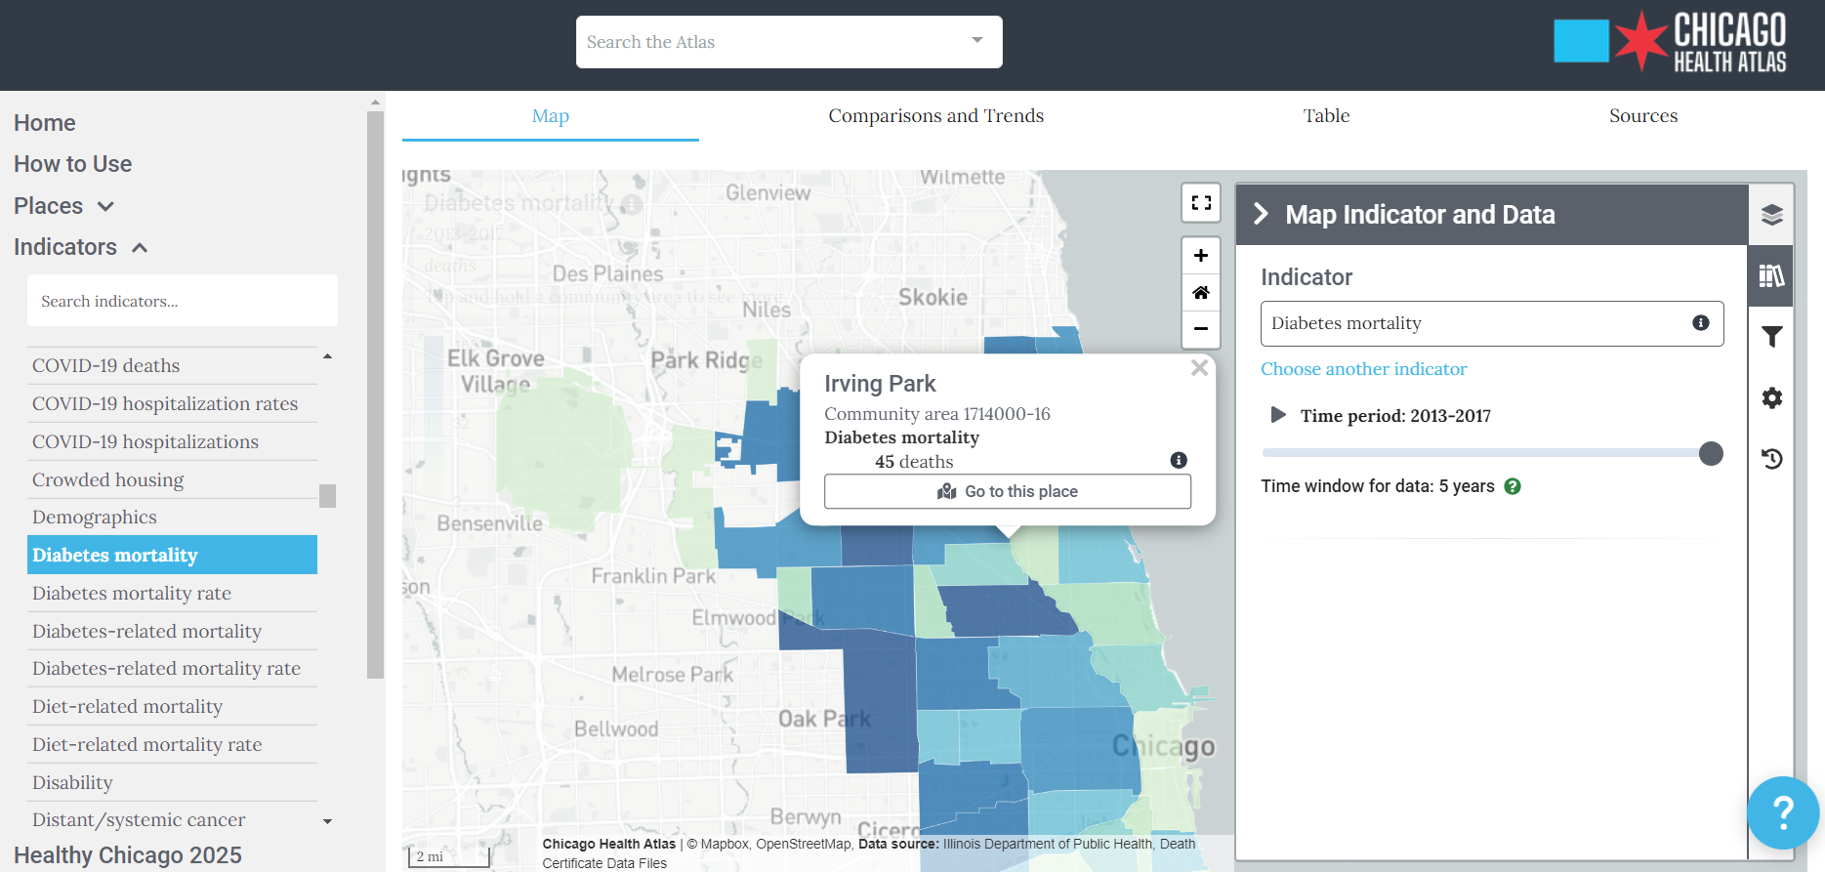

Slide 15
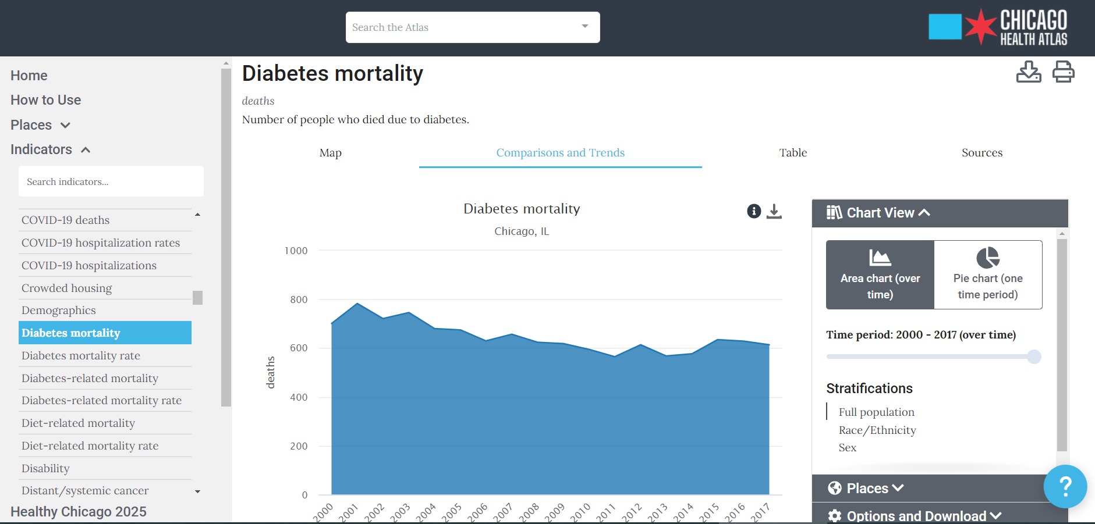

Slide 16
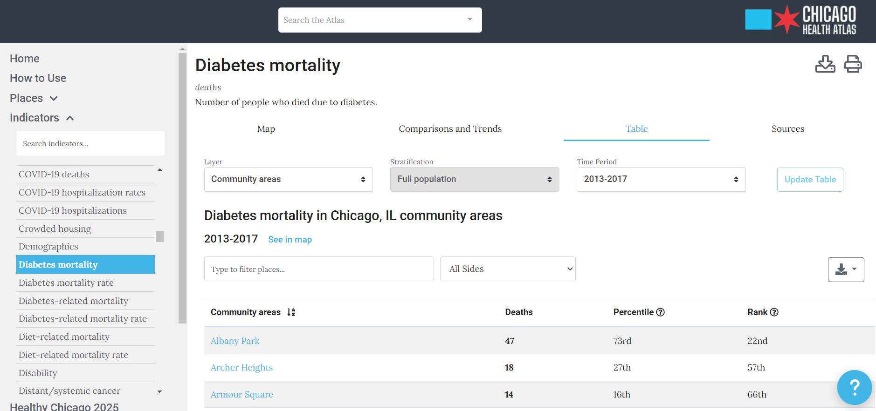

Slide 17
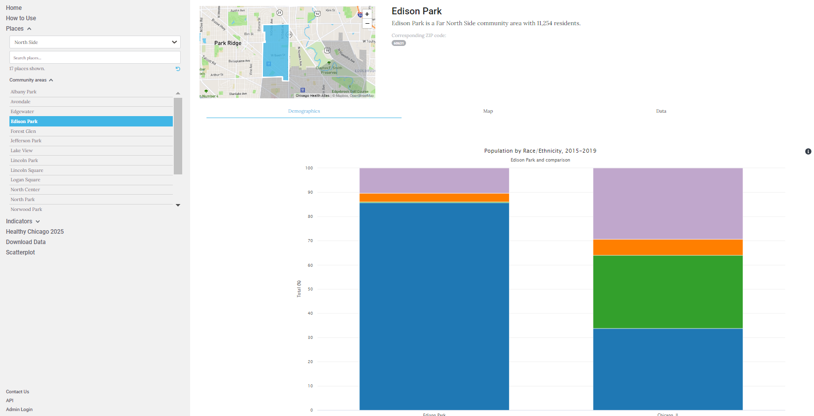

Slide 18
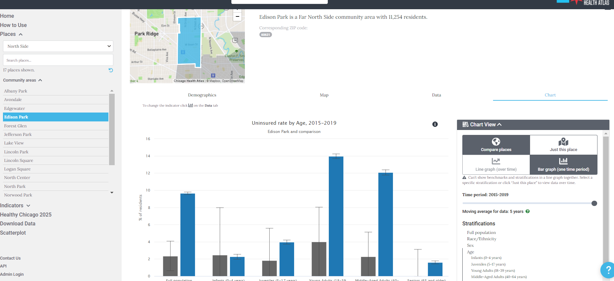

Slide 19
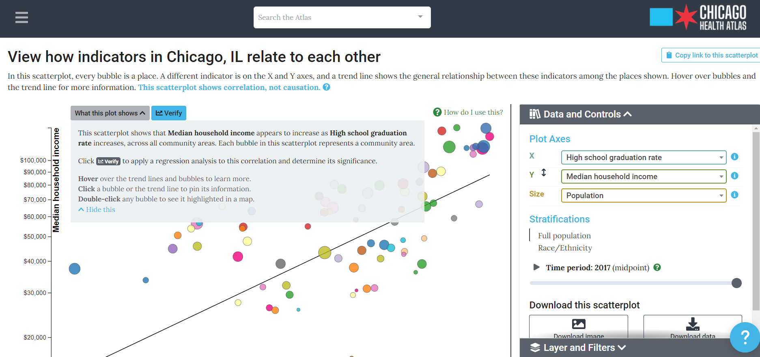

Slide 20
Comparing Chicago Justice Qs vs BJS Qs
Add this post call;

Slide 21
Overall – How to Add/Subtract Qs

